Slide 1
How Crowdsourcing Enabled Computer Vision
Notes:
https://vimeo.com/513555657

Slide 2
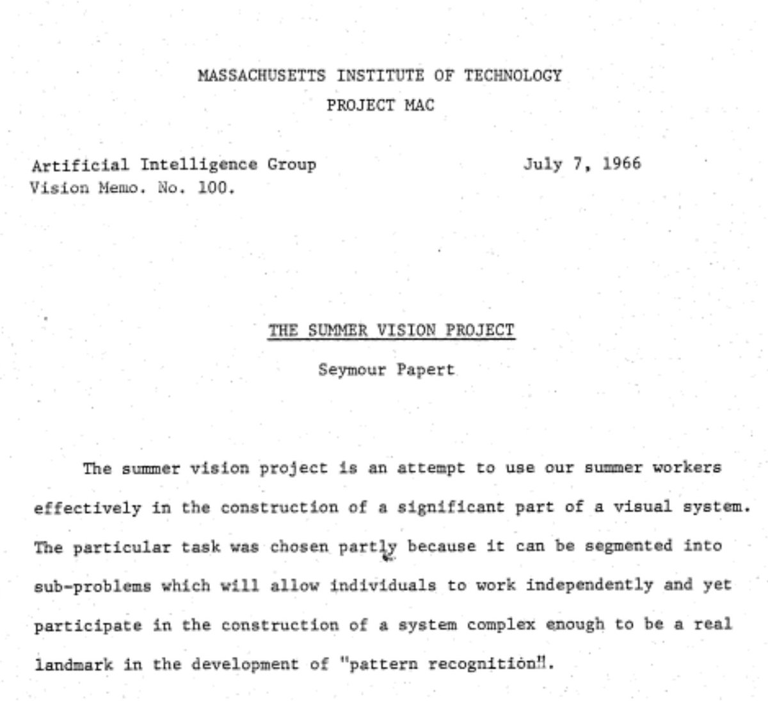
“Connect a television camera to a computer and get the machine to describe what it sees.”

Slide 6


Slide 9
The representation and matching of pictorial structures,
Fischler and Elschlager, 1973

Slide 10
Perceptual organization and the representation of natural form
Alex Pentland, 1986

Slide 11
Backpropagation applied to handwritten zip code recognition, Lecun et al., 1989

Slide 12
Rapid Object Detection using a Boosted Cascade of Simple Features
Viola and Jones, CVPR 2001

Slide 13
Histograms of oriented gradients for human detection
Dalal and Triggs, CVPR 2005.

Slide 14
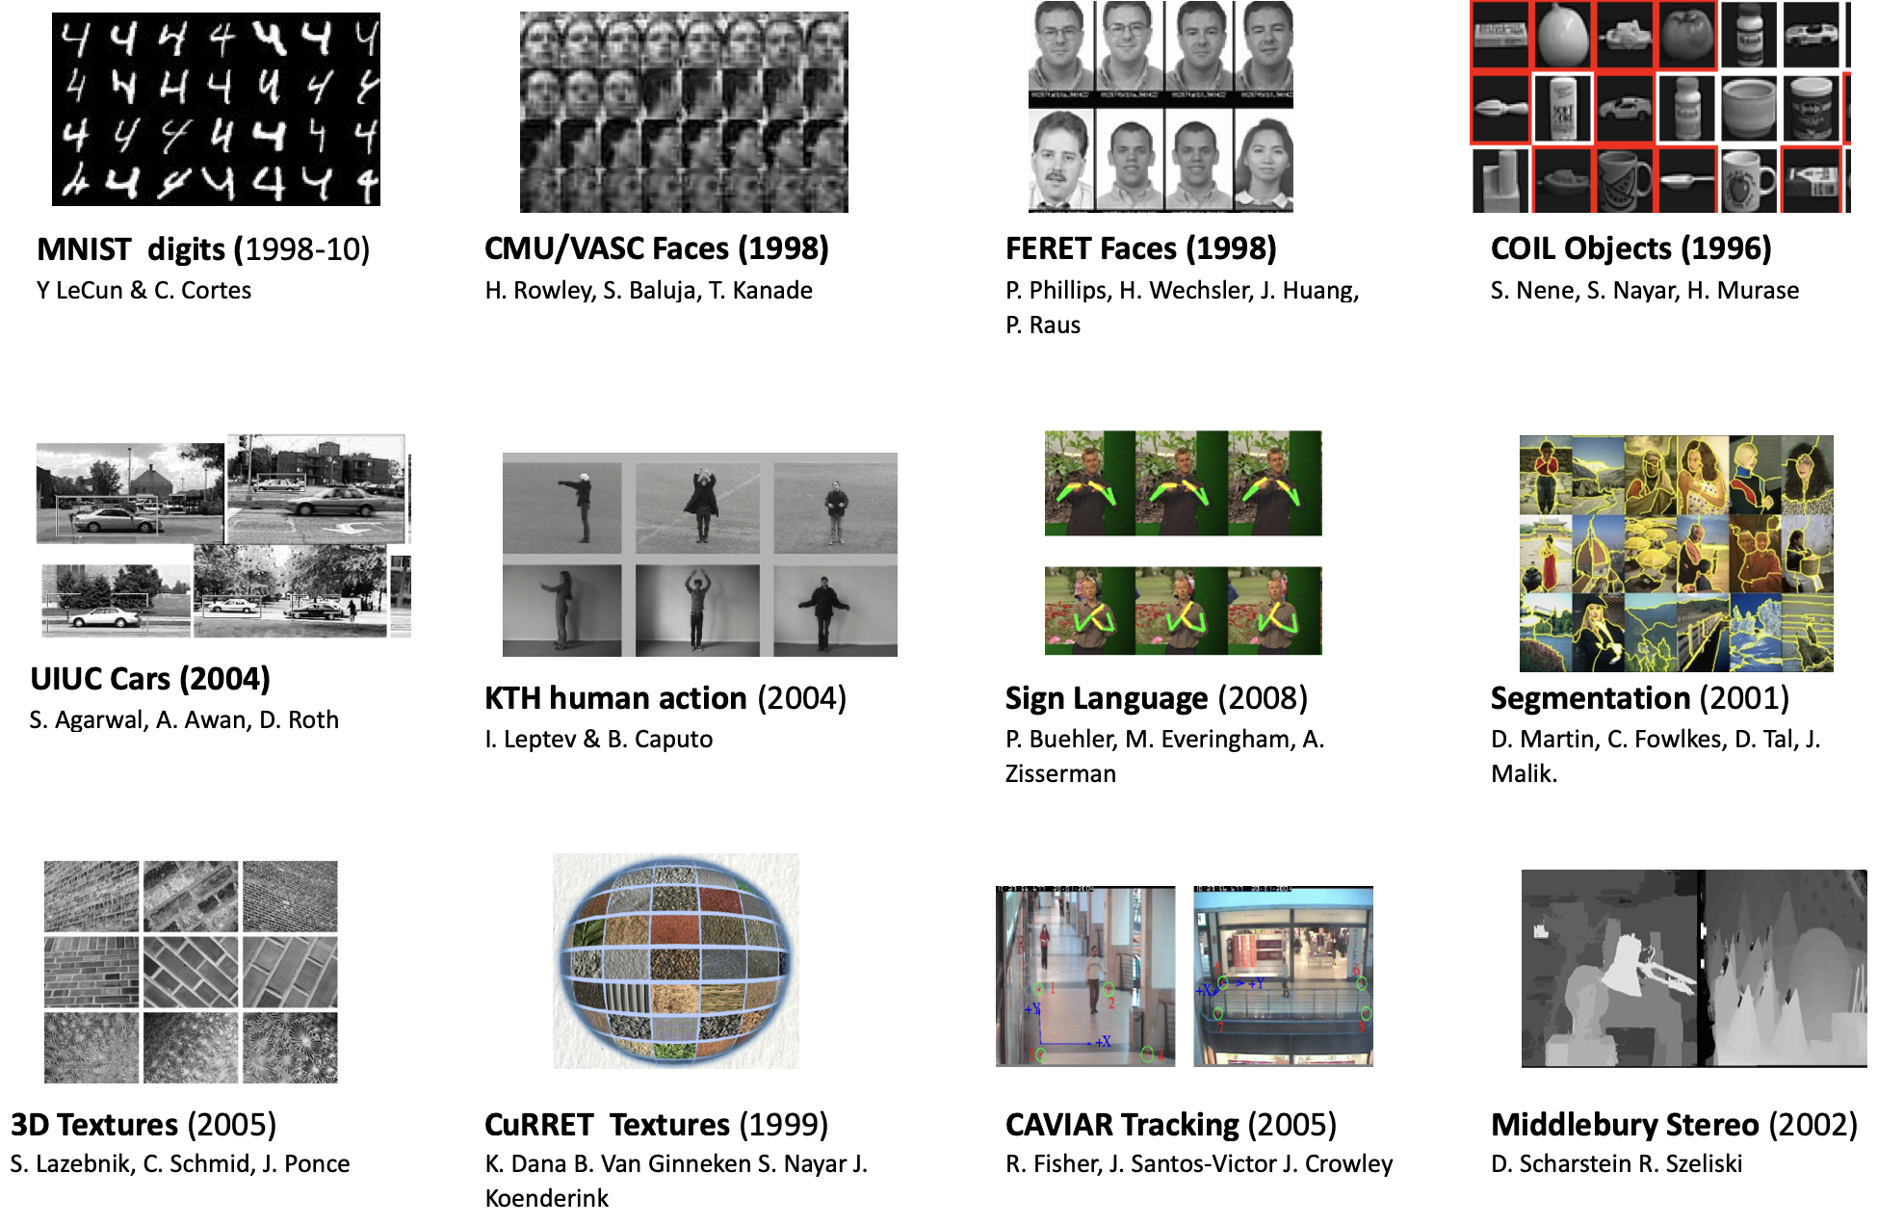
Datasets and Computer Vision

Slide 15
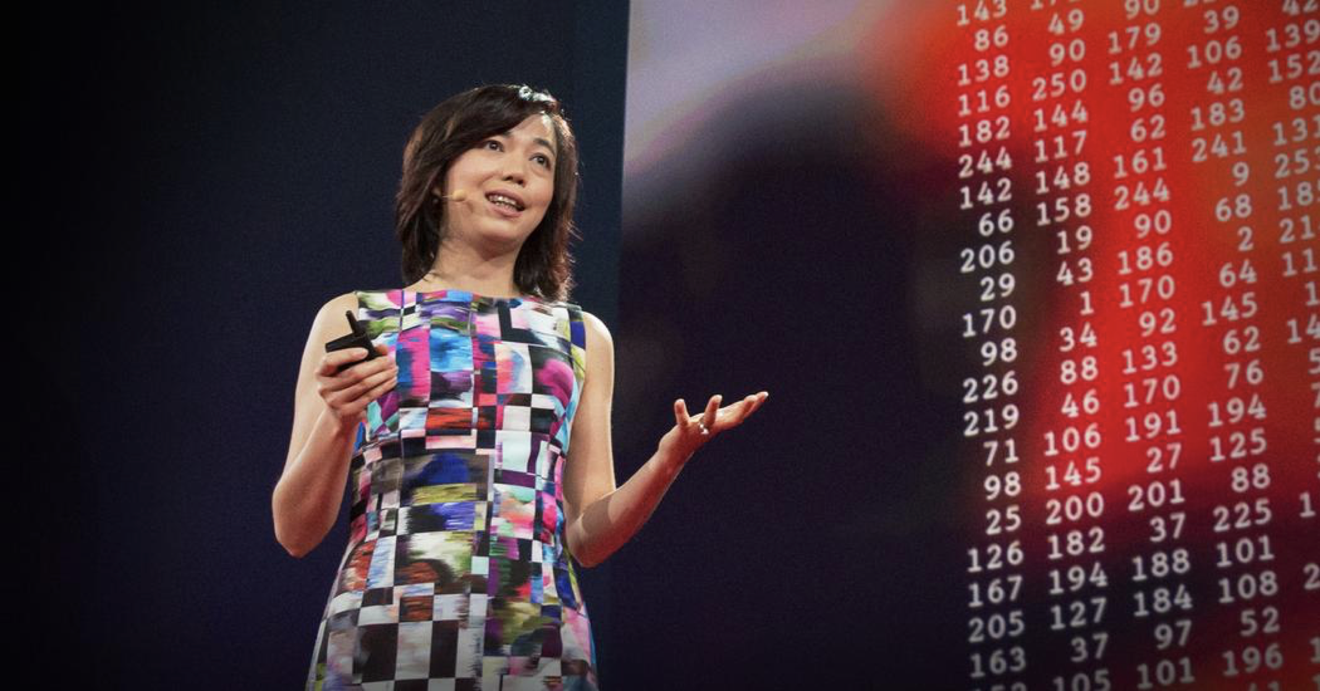
In 2006 Fei-Fei Li was a new CS professor at UIUC. Everyone was trying to develop better algorithms that would make better decisions, regardless of the data.

Slide 16
But she realized a limitation to this approach—the best algorithm wouldn’t work well if the data it learned from didn’t reflect the real world.
Her solution: build a better dataset.

Slide 17
“We decided we wanted to do something that was completely historically unprecedented. We’re going to map out the entire world of objects.” The resulting dataset was called ImageNet

Slide 18

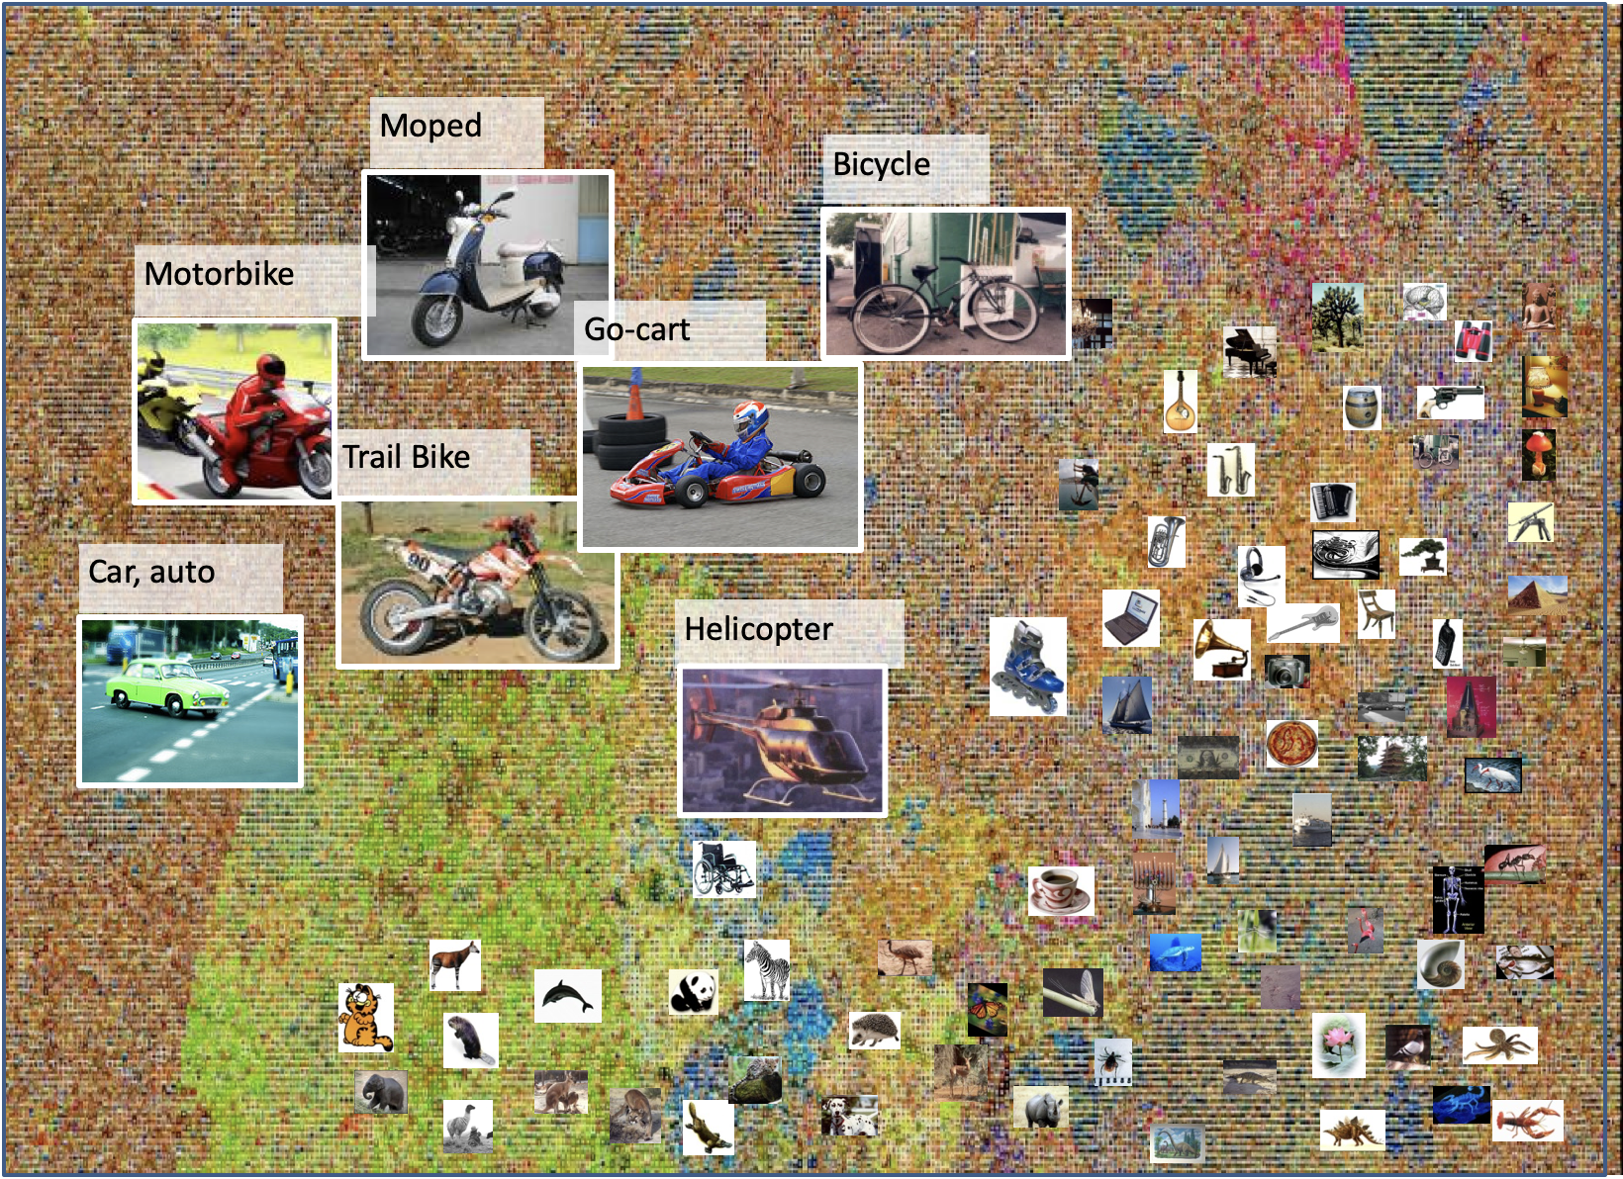
What is

Slide 19
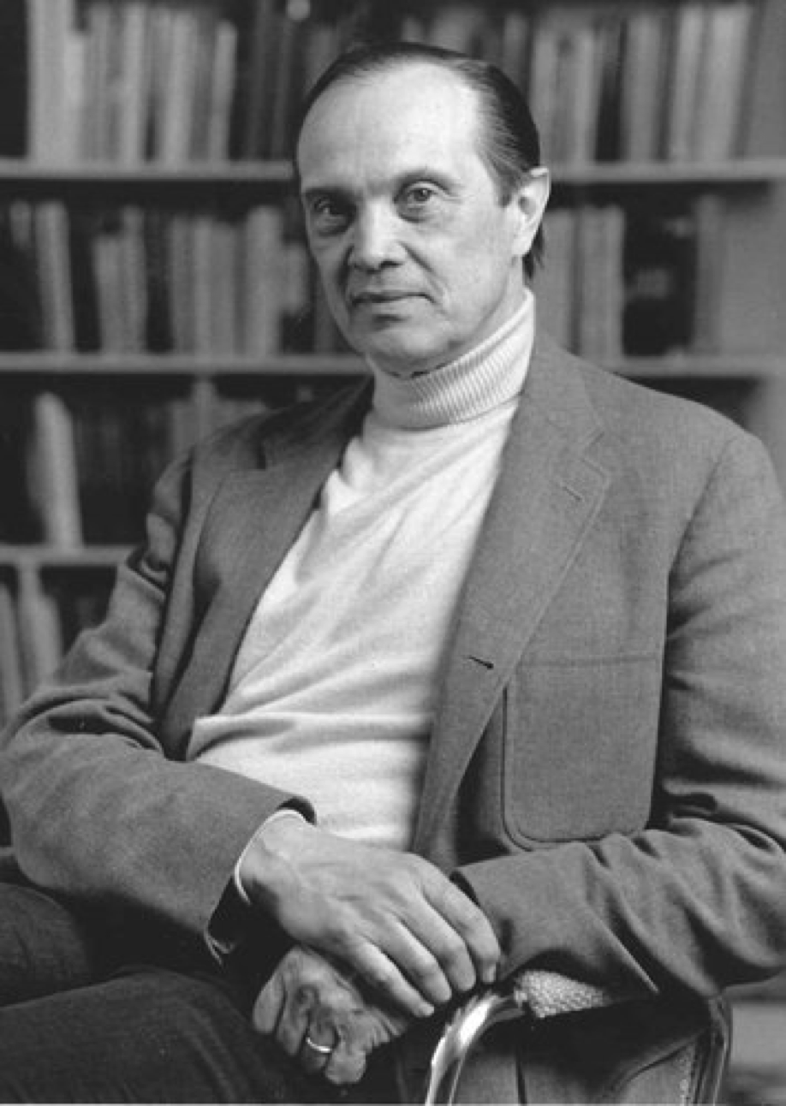
In the late 1980s, Princeton psychologist George Miller started a project called WordNet, with the aim of building a hierarchal structure for the English language. For example, dog is-a canine is-a mammal. It helped to organize language into a machine-readable logic, indexed more than 155,000 words.

Slide 20
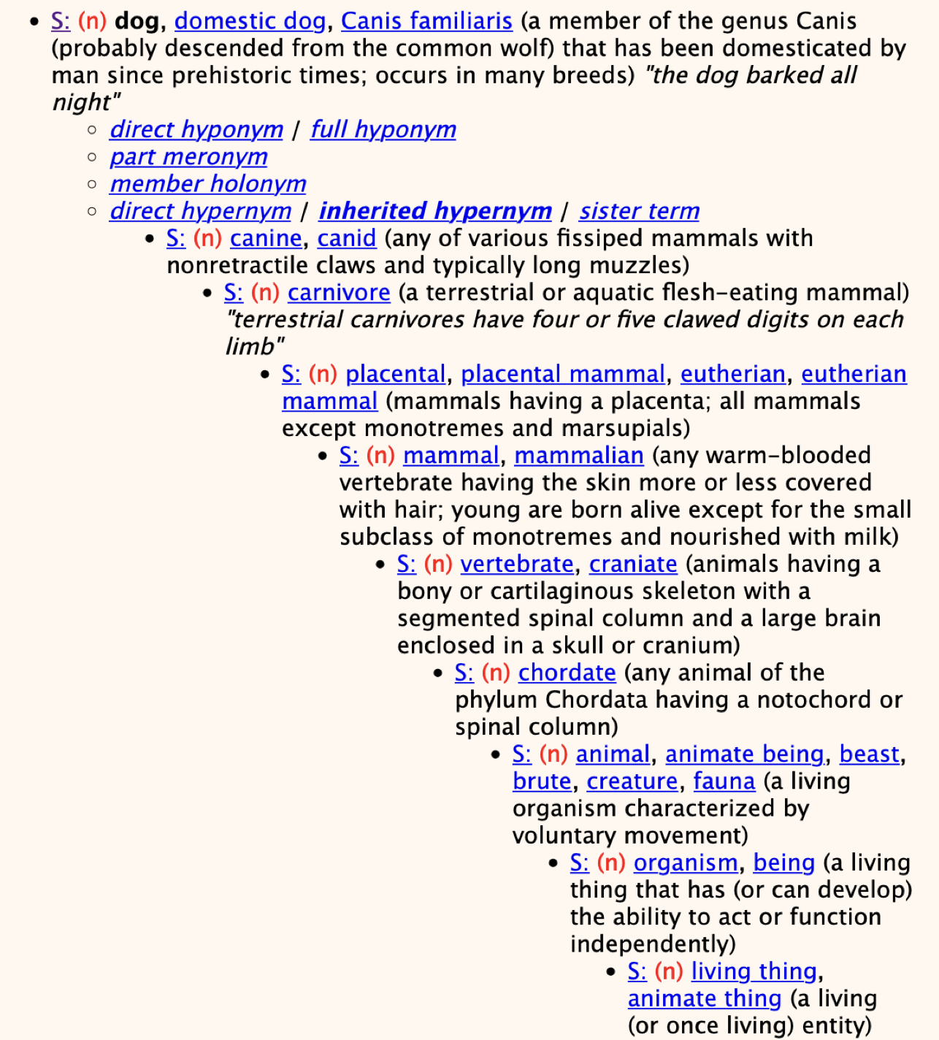
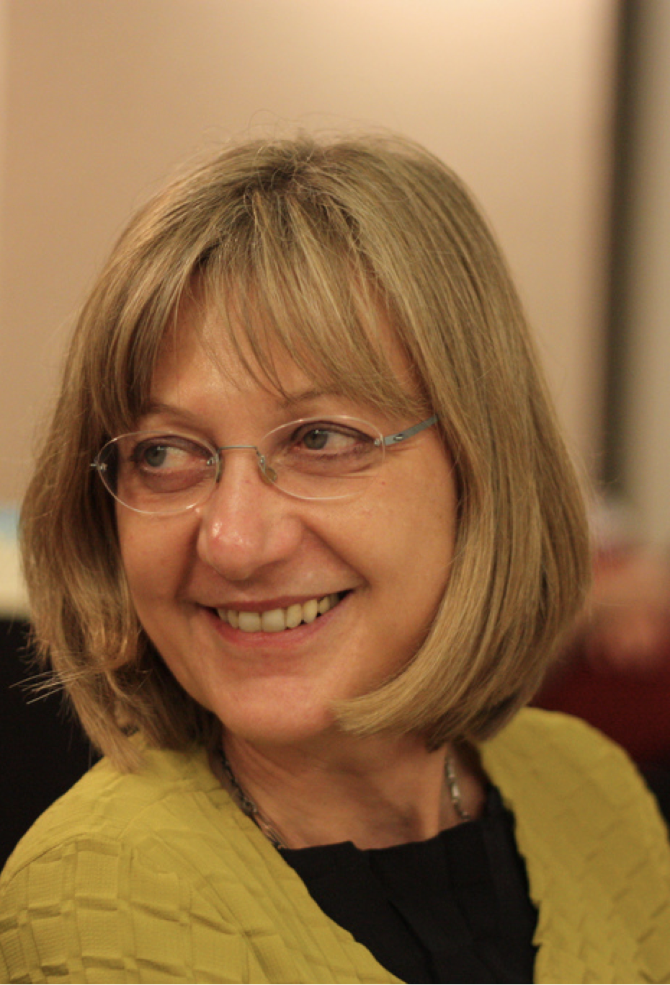
Christiane Fellbaum

Slide 21

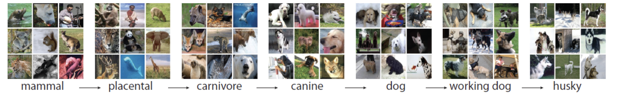
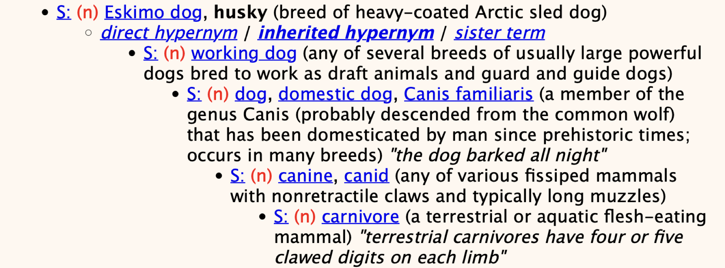
ontology

Slide 22

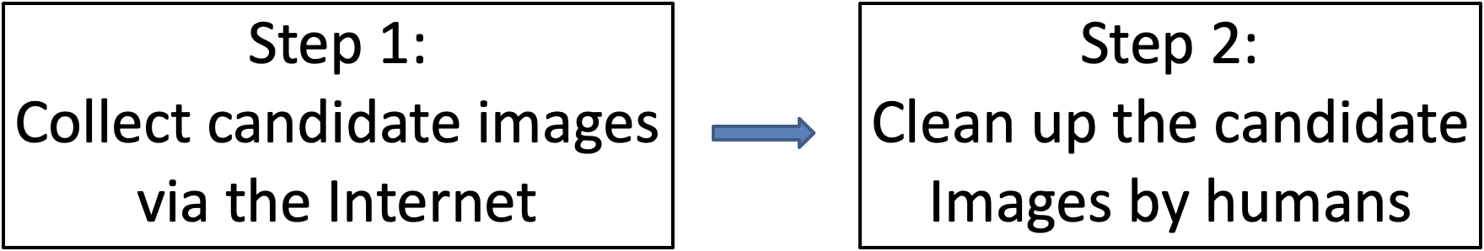
Constructing

Slide 23

Step 1: Collect Candidate Images from the Internet
Query expansion
Synonyms: German shepherd, German police dog, German shepherd dog, Alsatian
Appending words from ancestors: sheepdog, dog
Collect images from multiple internet search engines

Slide 24
Step 1: Collect Candidate Images from the Internet
“Mammal” subtree (1180 synsets)
Average # of images per synset: 10.5K
Most populated | Least populated
Humankind (118.5k) | Algeripithecus minutus (90)
Kitty, kitty-cat ( 69k) | Striped muishond (107)
Cattle, cows ( 65k) | Mylodonitid (127)
Pooch, doggie ( 62k) | Greater pichiciego (128)
Cougar, puma ( 57k) | Damaraland mole rat (188)
Frog, toad ( 53k ) | Western pipistrel (196)
Hack, jade, nag (50k) | Muishond (215)

Slide 25
Step 1: Collect Candidate Images from the Internet
“Mammal” subtree (1180 synsets)
Average accuracy per synset: 26%
Most accurate | Least accurate
Bottlenose dolpin (80%) | Fanaloka (1%)
Meerkat (74%) | Pallid bat (3%)
Burmese cat (74%) | Vaquita (3%)
Humpback whale (69%) | Fisher cat (3%)
African elephant (63%) | Walrus (4%)
Squirrel (60%) | Grison (4%)
Domestic cat (59%) | Pika, Mouse hare (4%)

Slide 26
Constructing

Slide 27
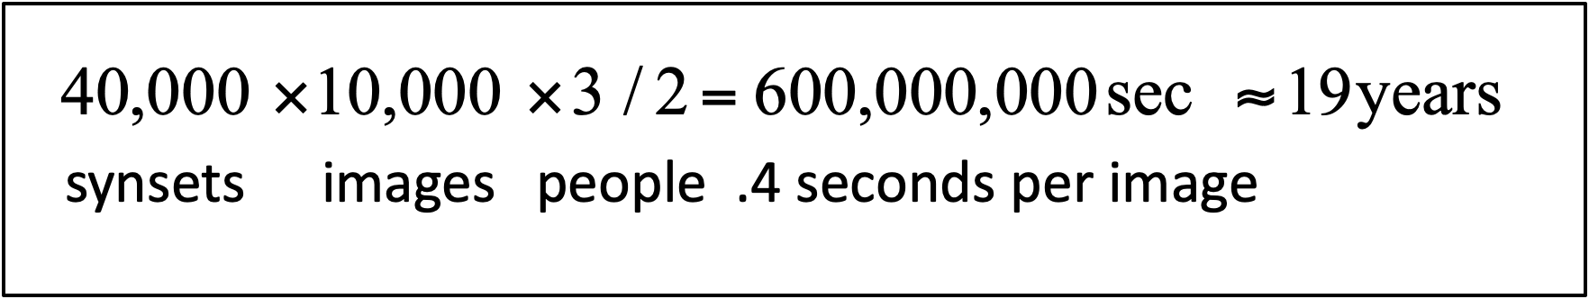
How long will it take?
Li’s first idea was to hire undergraduate students for $10 an hour to manually find images and add them to the dataset. But back-of-the-napkin math quickly made Li realize that at the undergrads’ rate of collecting images it would take too long to complete.

Slide 28
How long will it take?
After the undergrad task force was disbanded, Li and the team went back to the drawing board.
What if computer-vision algorithms could pick the photos from the internet, and humans would then just curate the images?
But the team decided the technique wasn’t sustainable either—future algorithms would be constricted to only judging what algorithms were capable of recognizing at the time the dataset was compiled.

Slide 29
How long will it take?
Undergrads were time-consuming, algorithms were flawed, and the team didn’t have money—Li said the project failed to win any of the federal grants she applied for, receiving comments on proposals that it was shameful Princeton would research this topic, and that the only strength of proposal was that Li was a woman.

Slide 30
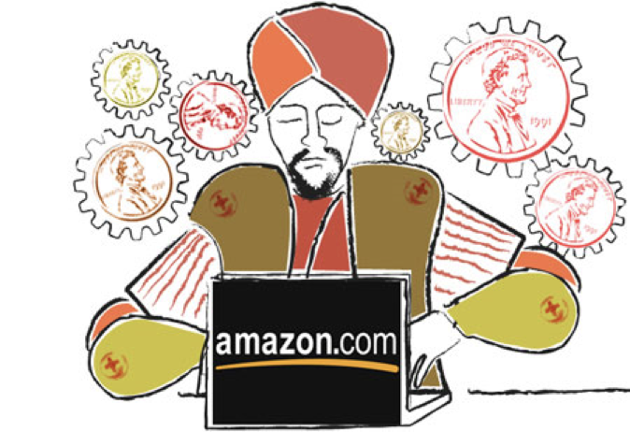
How long will it take?
A solution finally surfaced in a chance hallway conversation with a graduate student who asked Li whether she had heard of Amazon Mechanical Turk, a service where hordes of humans sitting at computers around the world would complete small online tasks for pennies.
“He showed me the website, and I can tell you literally that day I knew the ImageNet project was going to happen,” she said. “Suddenly we found a tool that could scale, that we could not possibly dream of by hiring Princeton undergrads.”
“The data that transformed AI research—and possibly the world”
By Dave Gershgorn
July 26, 2017

Slide 31

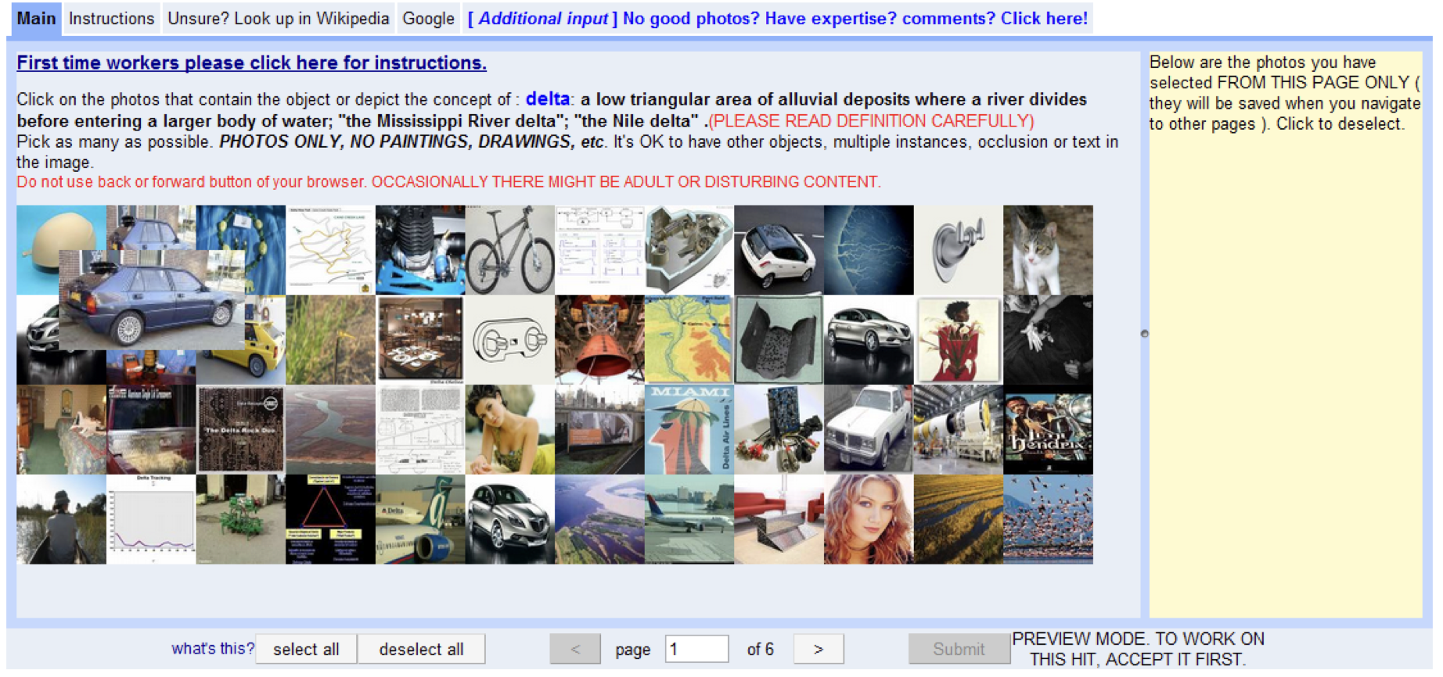
Basic User Interface
Click on the good images.

Slide 32
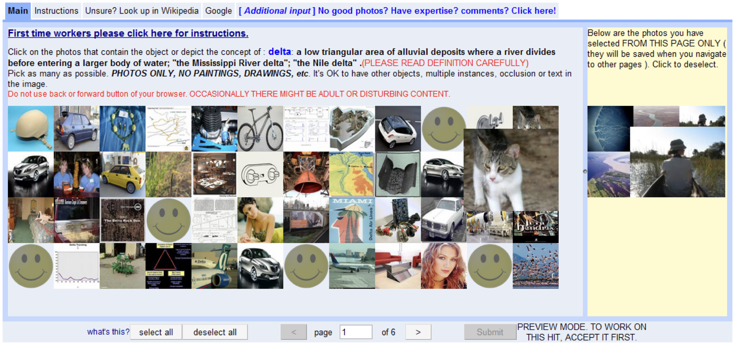
Basic User Interface

Slide 33
Mechanical Turk brought its own slew of hurdles, with much of the work fielded by two of Li’s Ph.D students, Jia Deng and Olga Russakovsky . For example, how many Turkers needed to look at each image? Maybe two people could determine that a cat was a cat, but an image of a miniature husky might require 10 rounds of validation. What if some Turkers tried to game or cheat the system? Li’s team ended up creating a batch of statistical models for Turker’s behaviors to help ensure the dataset only included correct images.
Even after finding Mechanical Turk, the dataset took two and a half years to complete. It consisted of 3.2 million labelled images, separated into 5,247 categories, sorted into 12 subtrees like “mammal,” “vehicle,” and “furniture.”

Slide 34
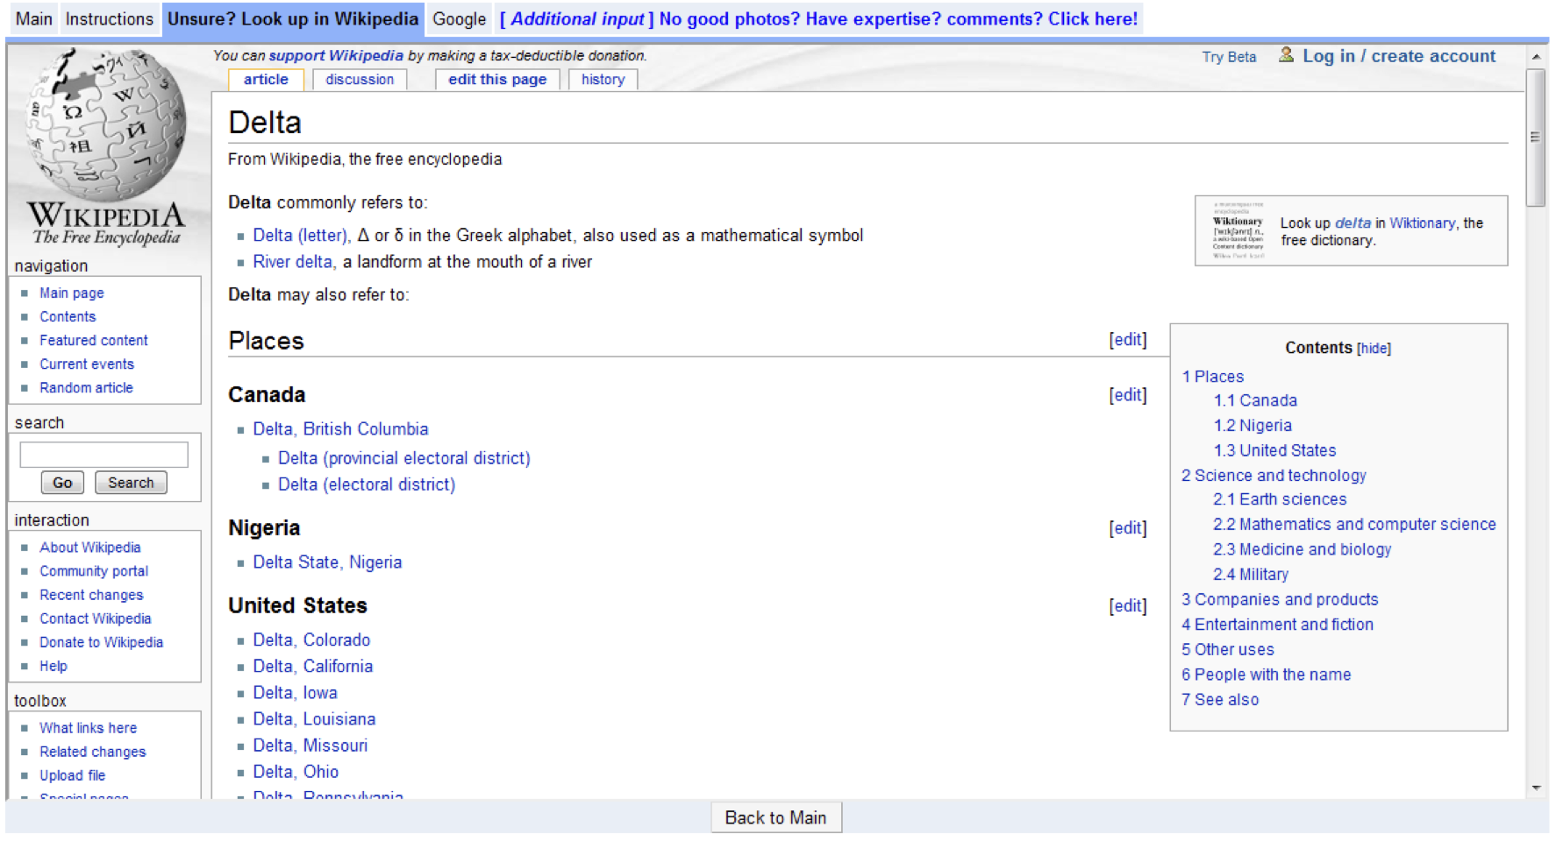
Enhancement 1
Provide wiki and google links

Slide 35
Enhancement 2
Make sure workers read the definition.
Words are ambiguous. E.g.
Box: any one of several designated areas on a ball field where the batter or catcher or coaches are positioned
Keyboard: holder consisting of an arrangement of hooks on which keys or locks can be hung
These synsets are hard to get right
Some workers do not read or understand the definition

Slide 36
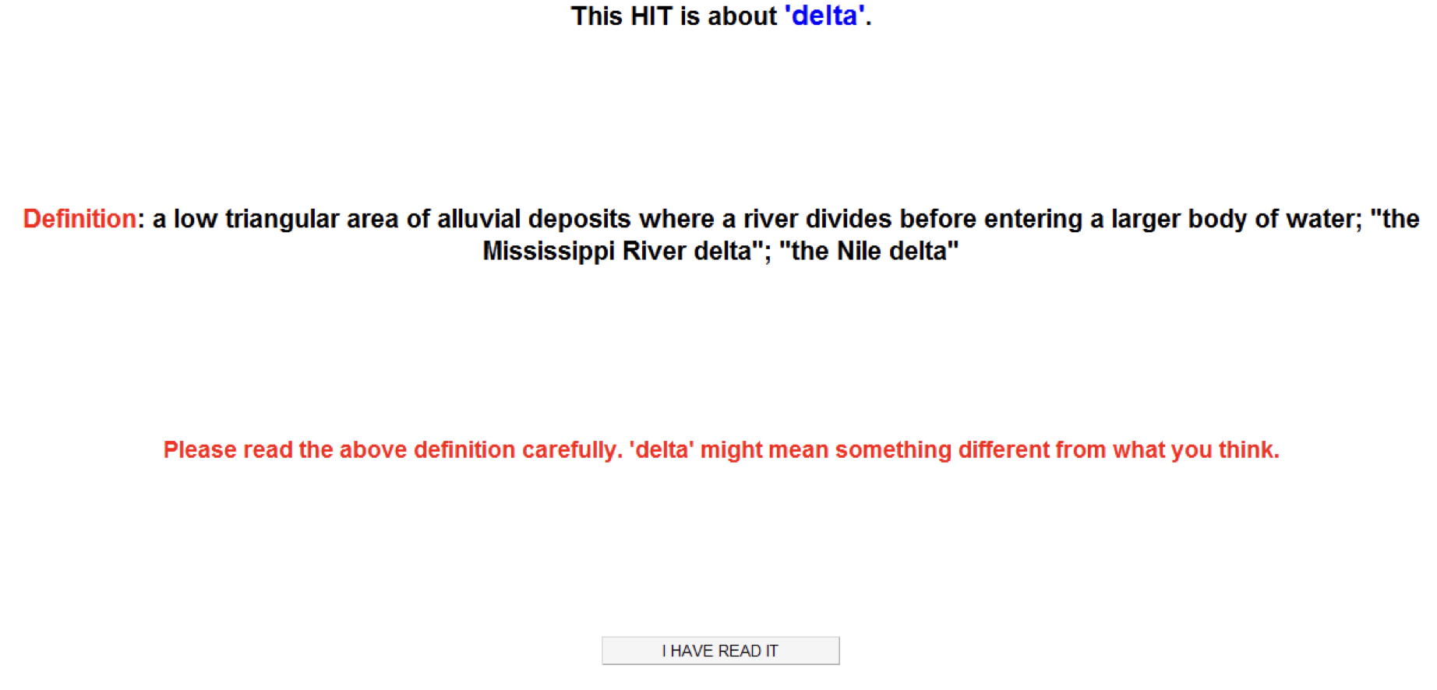
Definition Quiz

Slide 37
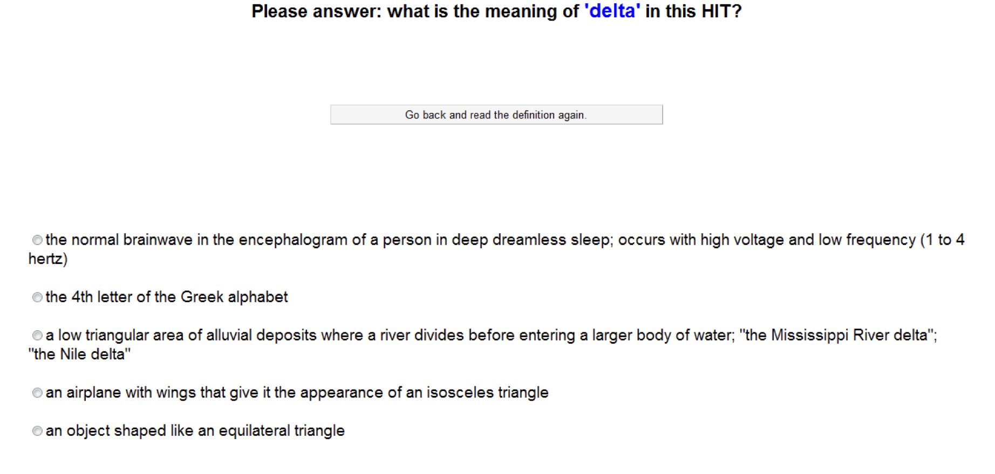
Definition Quiz

Slide 38
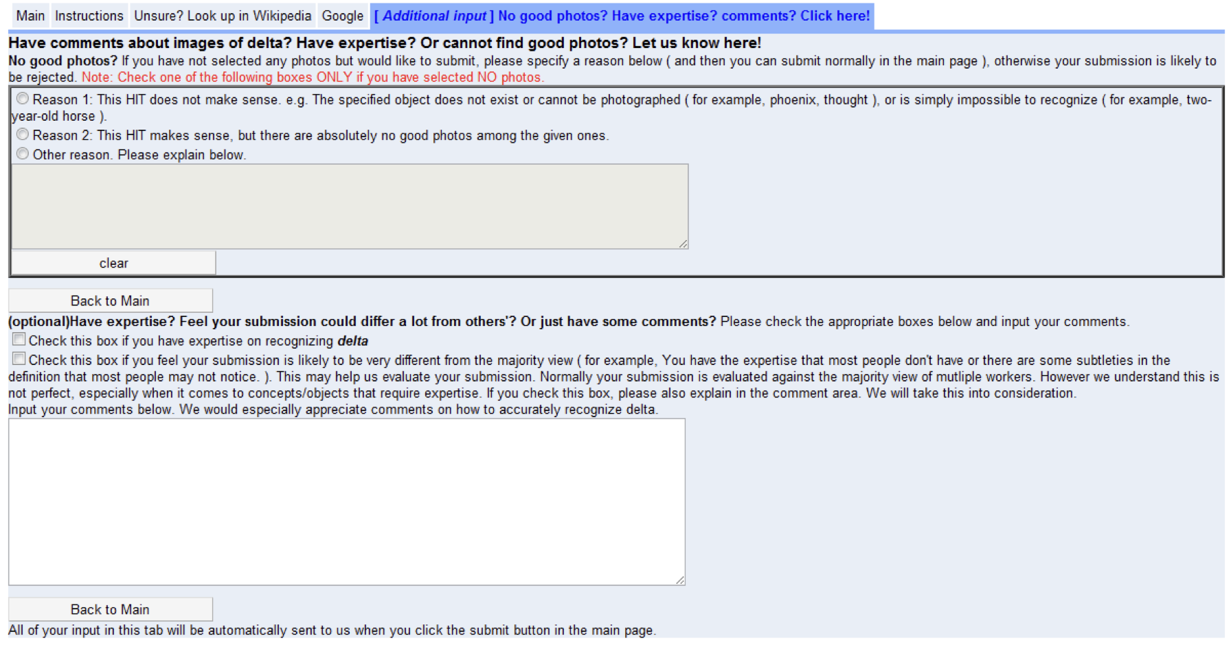
Enhancement 3
Allow more feedback. E.g. “unimagable synsets” expert opinion

Slide 39

is built by crowdsourcing
July 2008: 0 images
Dec 2008: 3 million images, 6000+ synsets
April 2010: 11 million images, 15,000+ synsets

Slide 40
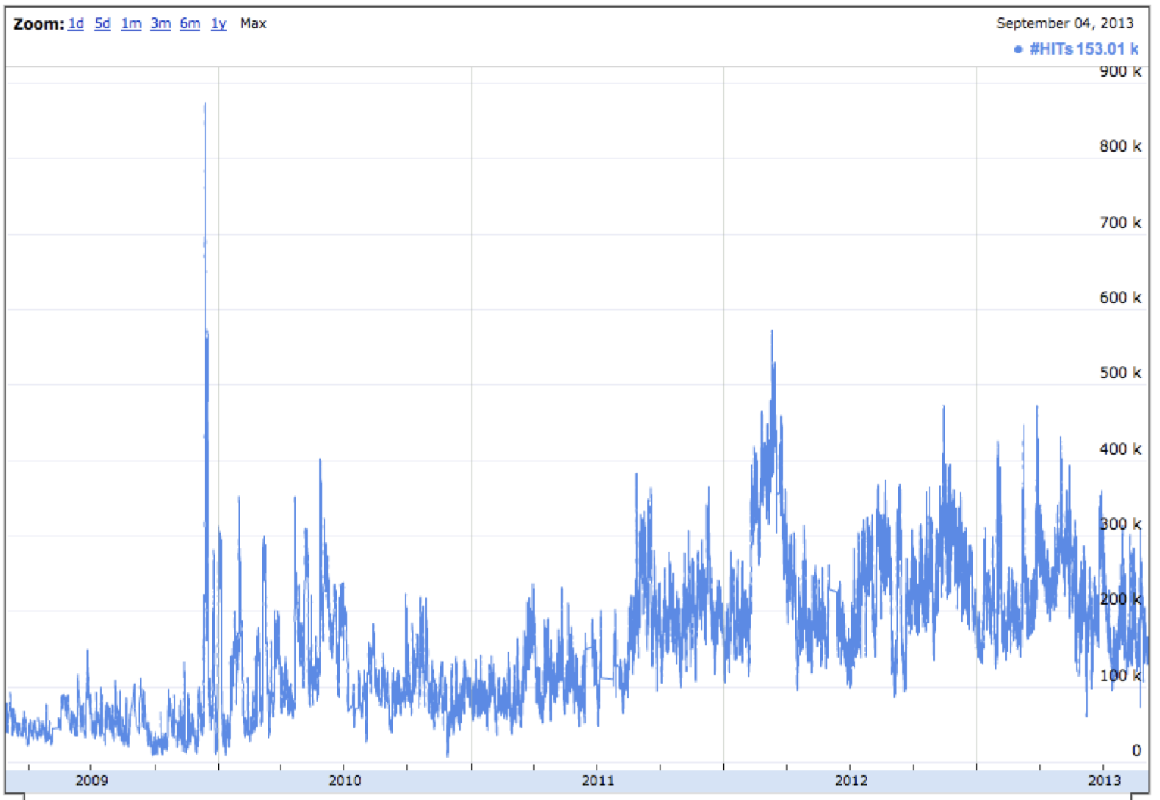

MTurk Tracker

Slide 41
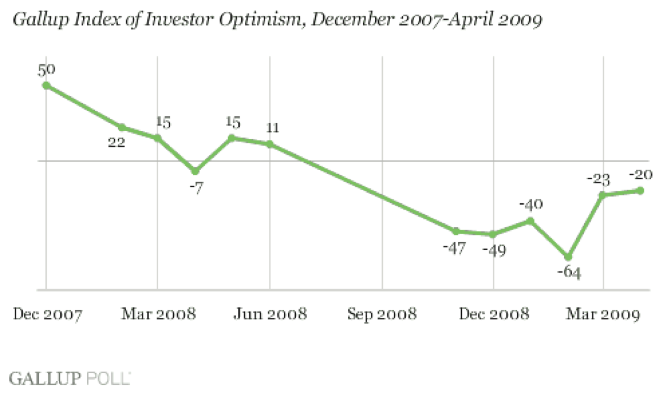
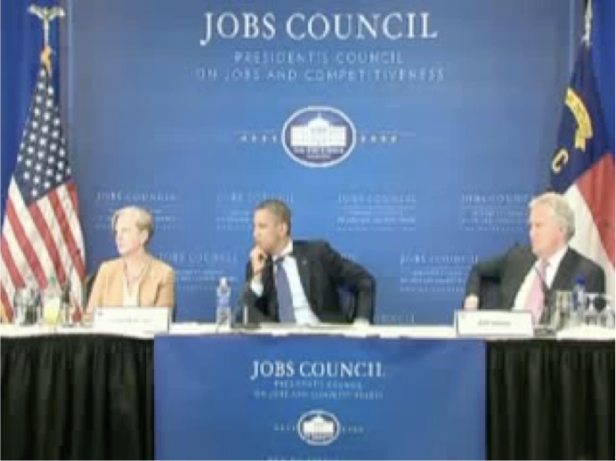
U.S economy 2008 - 2010

Slide 42
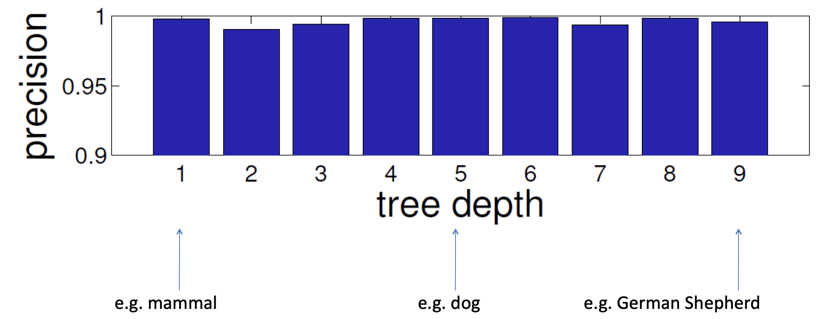
Accuracy
Deng, Dong, Socher, Li, Li, & Fei-Fei, CVPR, 2009

Slide 43
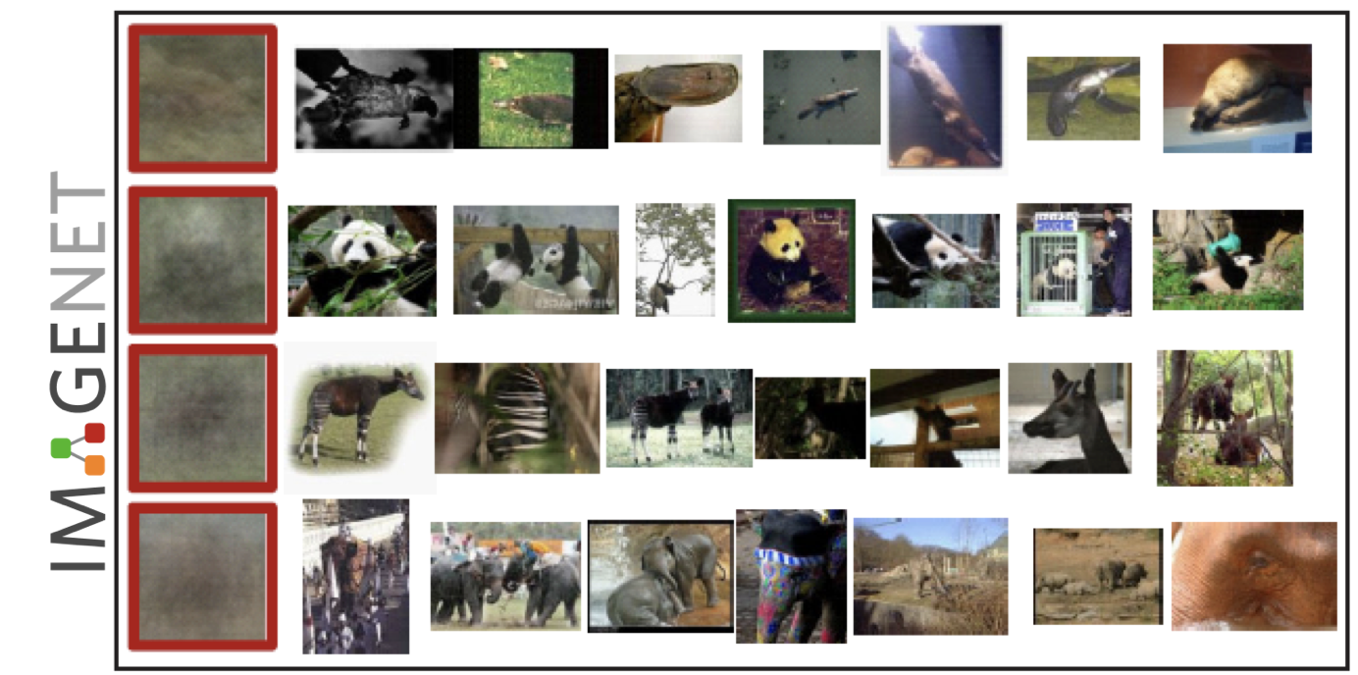
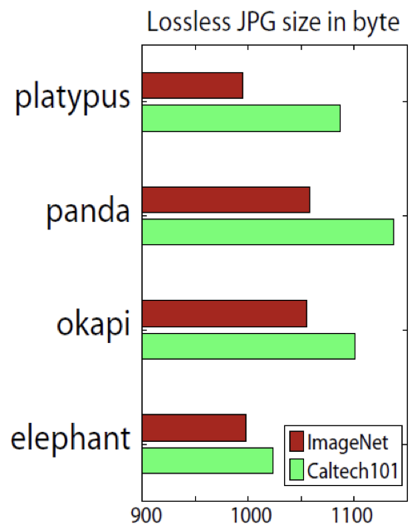
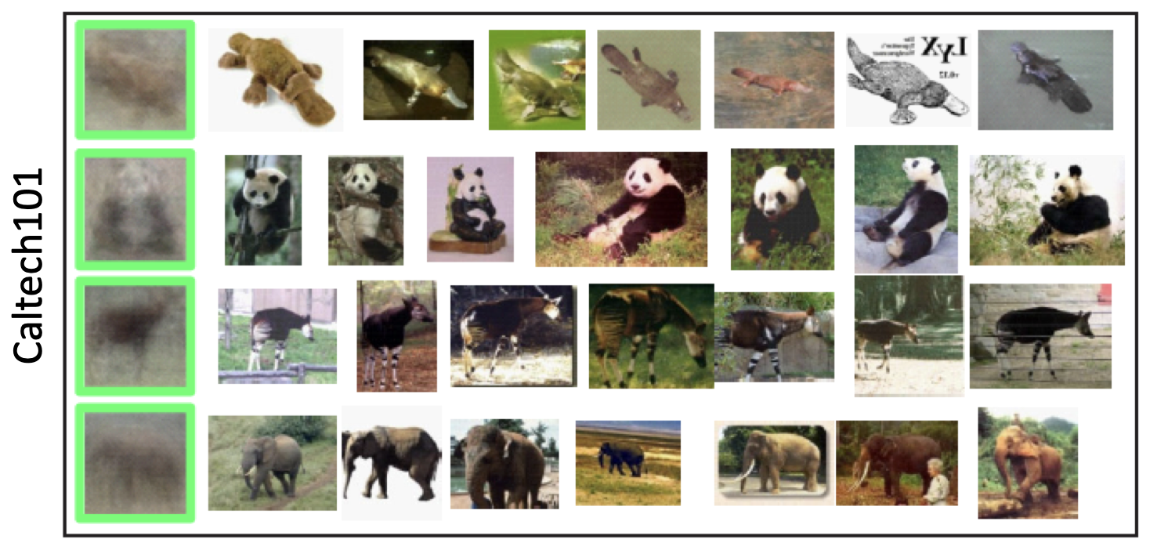
Diversity

Slide 44
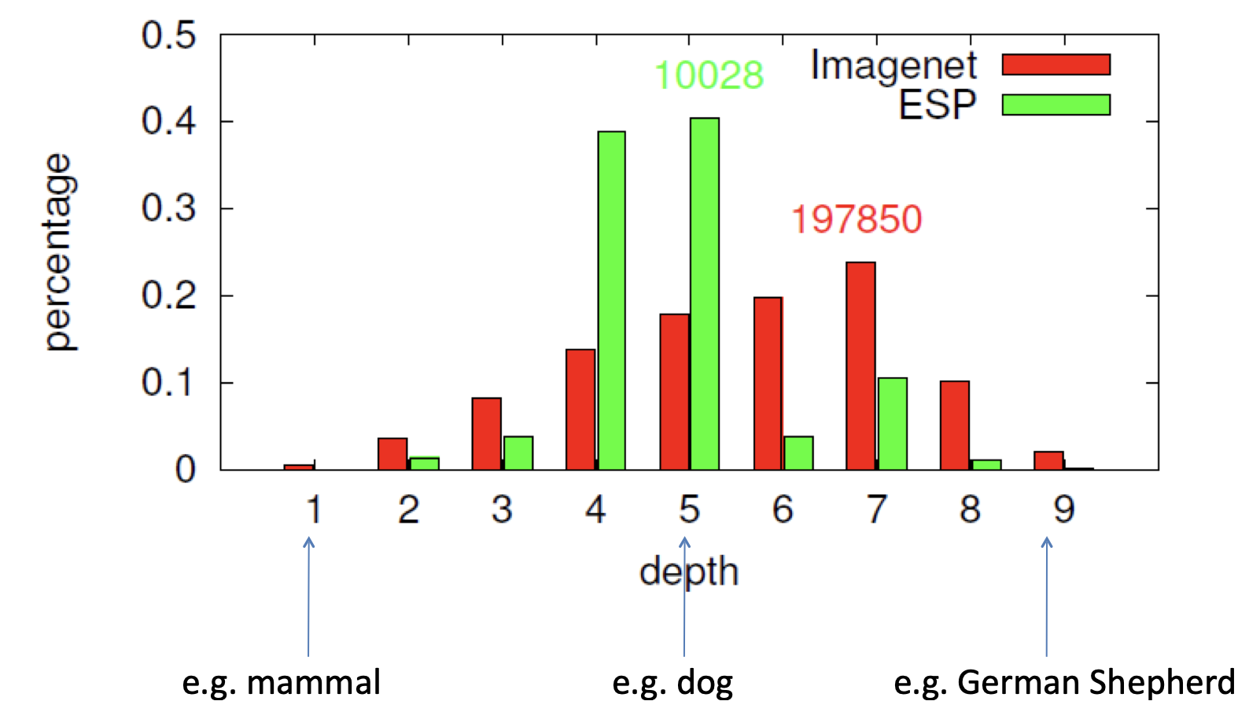
Diversity

Slide 45
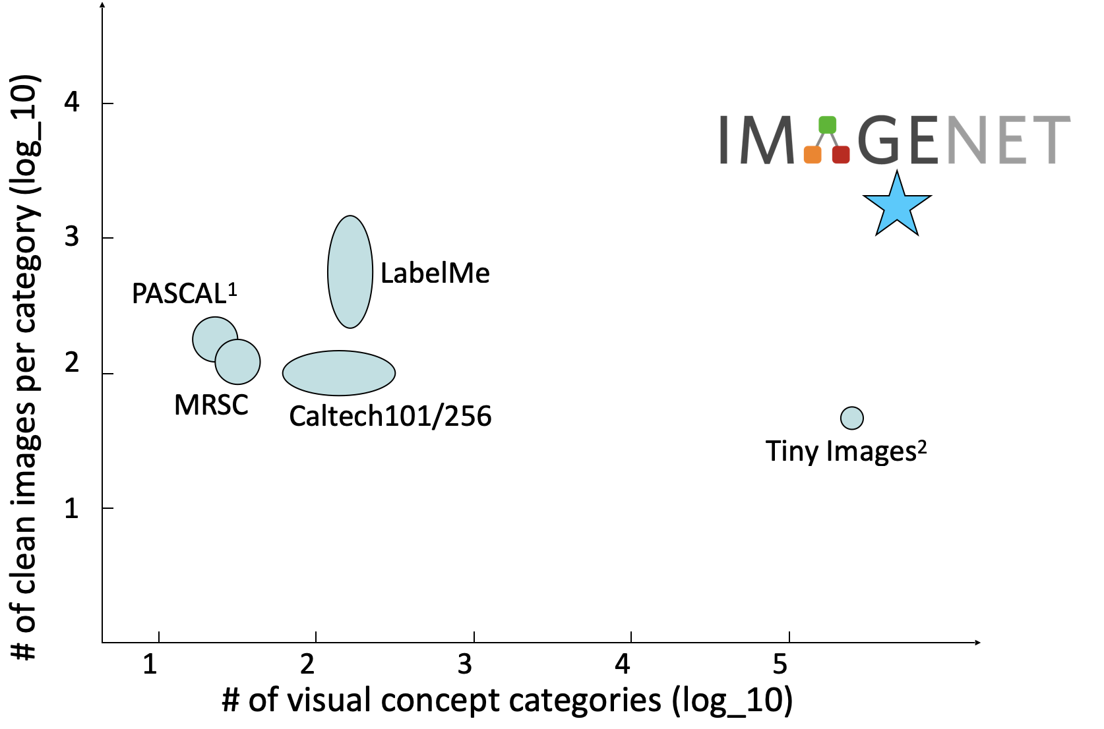
Comparison among free datasets
Excluding the Caltech101 datasets from PASCAL
2. No image in this dataset is human annotated. The # of clean images per category is a rough estimation

Slide 46
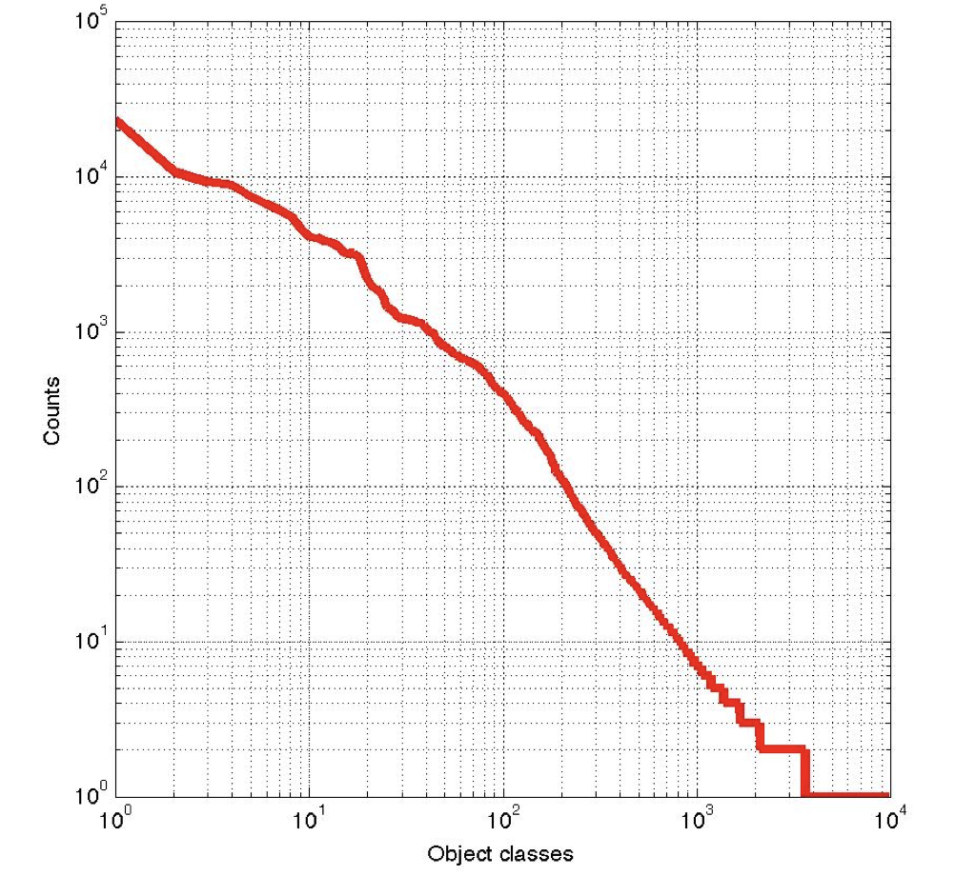
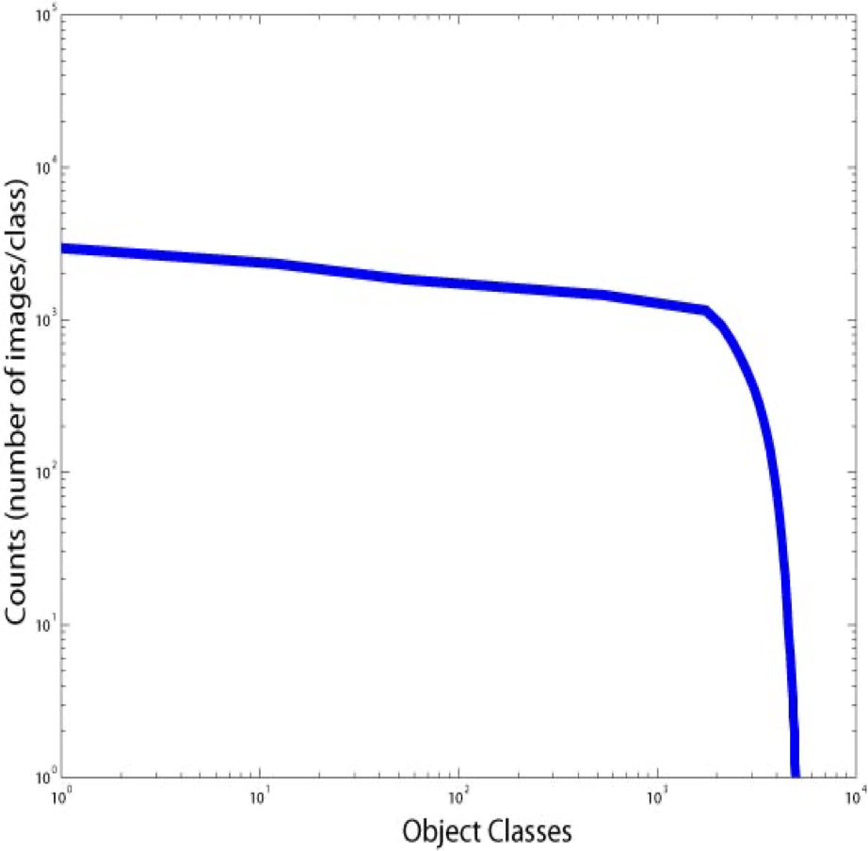

Scale
LabelMe
Russell et al. 2005;
statistics obtained in 2009

Slide 47
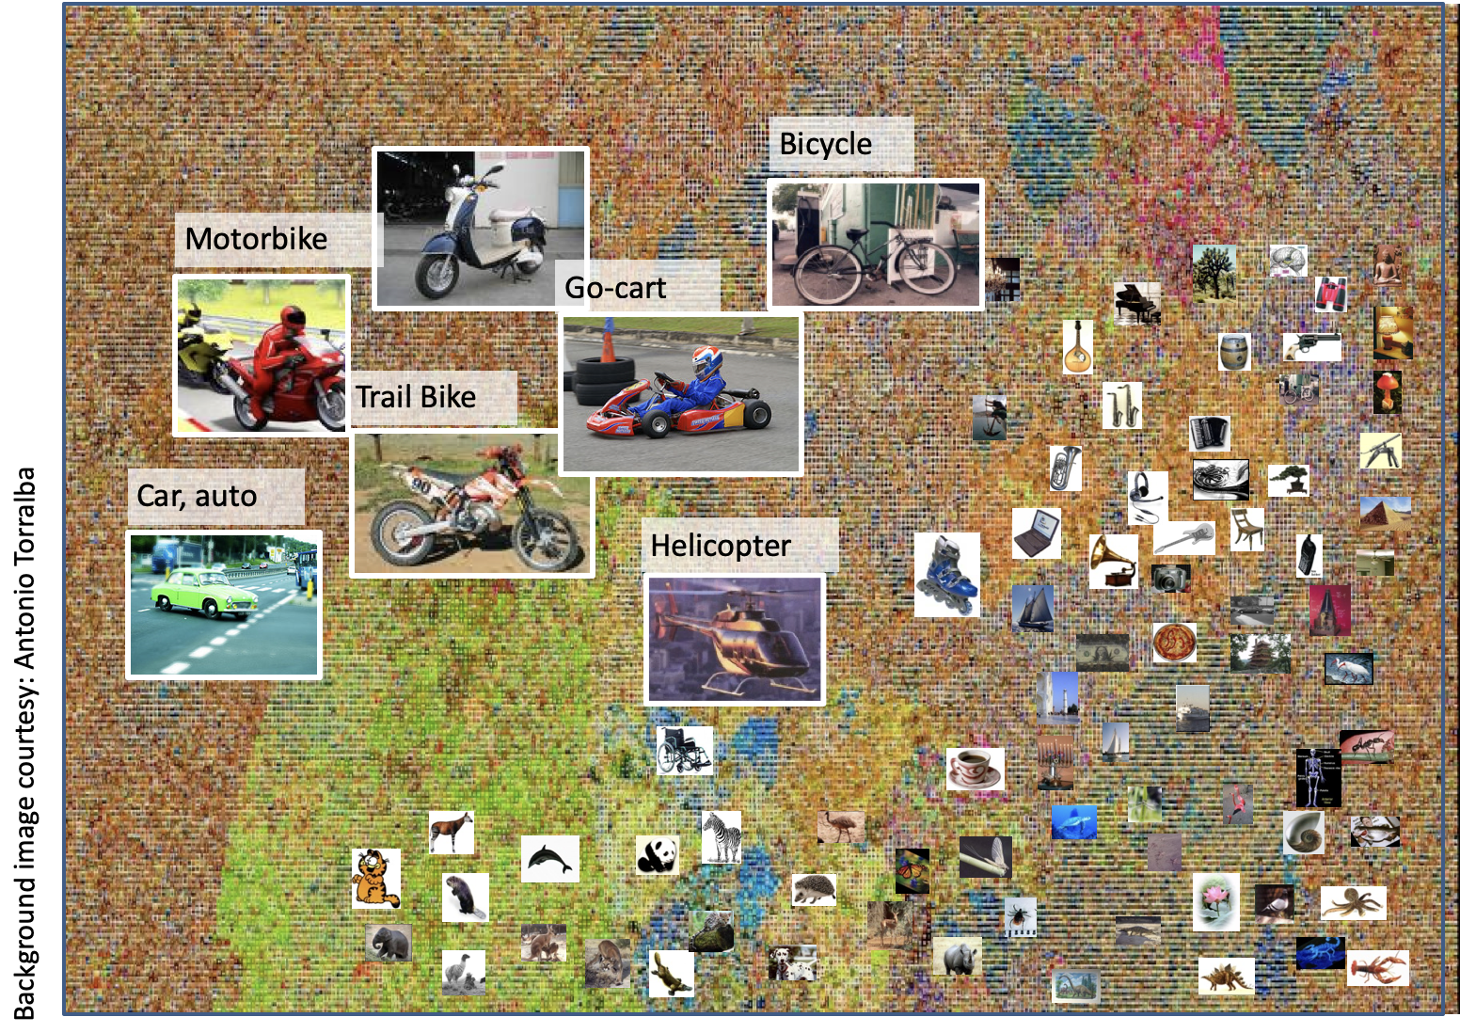
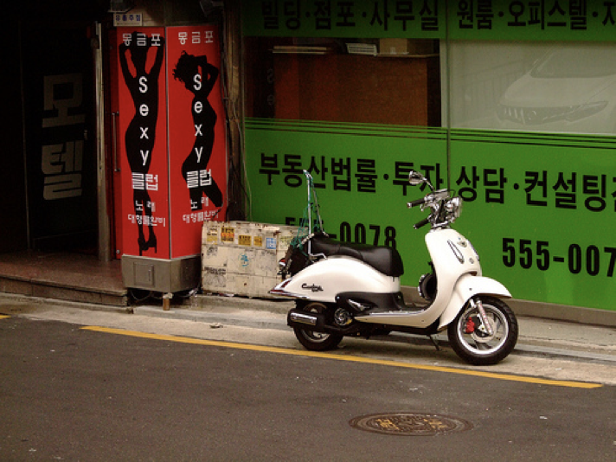
What does classifying more than 10,000 image categories tell us?

Slide 48
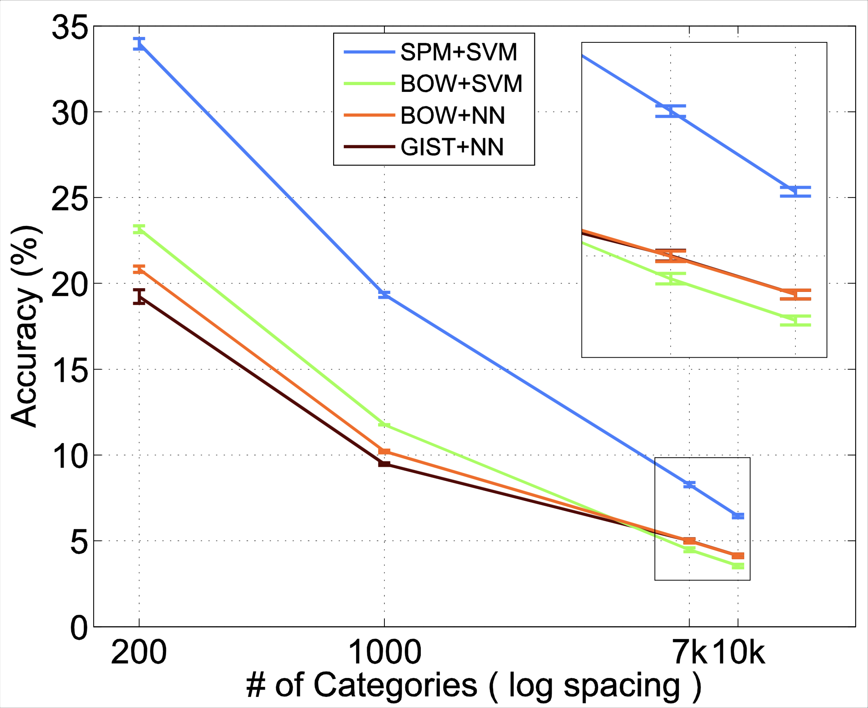
Size matters
6.4% for 10K categories
Better than we expected (instead of dropping at the rate of 10x; it is roughly at about 2x)
An ordering switch between SVM and NN methods when the # of categories become large
Deng, Berg, Li, & Fei-Fei, ECCV2010

Slide 49
Li, Berg, and Deng authored five papers together based on the dataset, exploring how algorithms would interpret such vast amounts of data. The first paper would become a benchmark for how an algorithm would react to thousands of classes of images, the predecessor to the ImageNet competition.
“We realized to democratize this idea we needed to reach out further,” Li said. She approached a well-known image recognition competition in Europe called PASCAL VOC, which agreed to collaborate and co-brand their competition with ImageNet. The PASCAL challenge was a well-respected competition and dataset, but representative of the previous method of thinking. It only had 20 classes, compared to ImageNet’s 1,000.

Slide 50
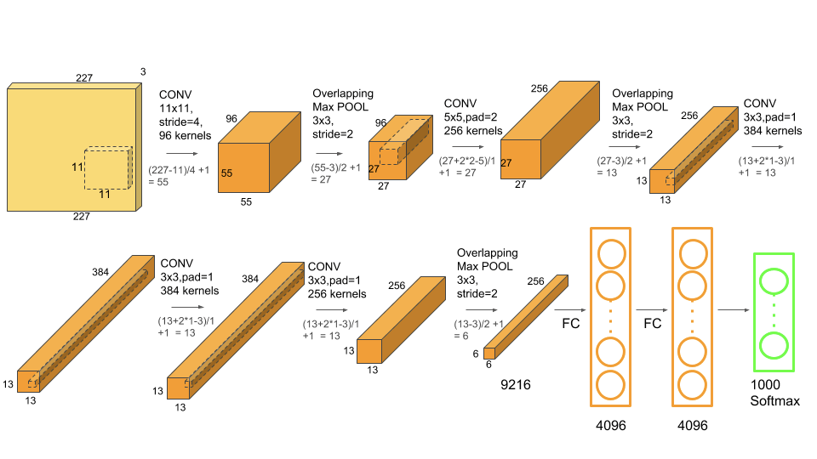
Two years after the first ImageNet competition, in 2012, something even bigger happened. Indeed, if the artificial intelligence boom we see today could be attributed to a single event, it would be the announcement of the 2012 ImageNet challenge results.
Geoffrey Hinton, Ilya Sutskever, and Alex Krizhevsky submitted a deep convolutional neural network architecture called AlexNet which beat the field by a whopping 10.8 percentage point margin, which was 41% better than the next best.
The data that transformed AI research—and possibly the world
By Dave Gershgorn
July 26, 2017

Slide 51
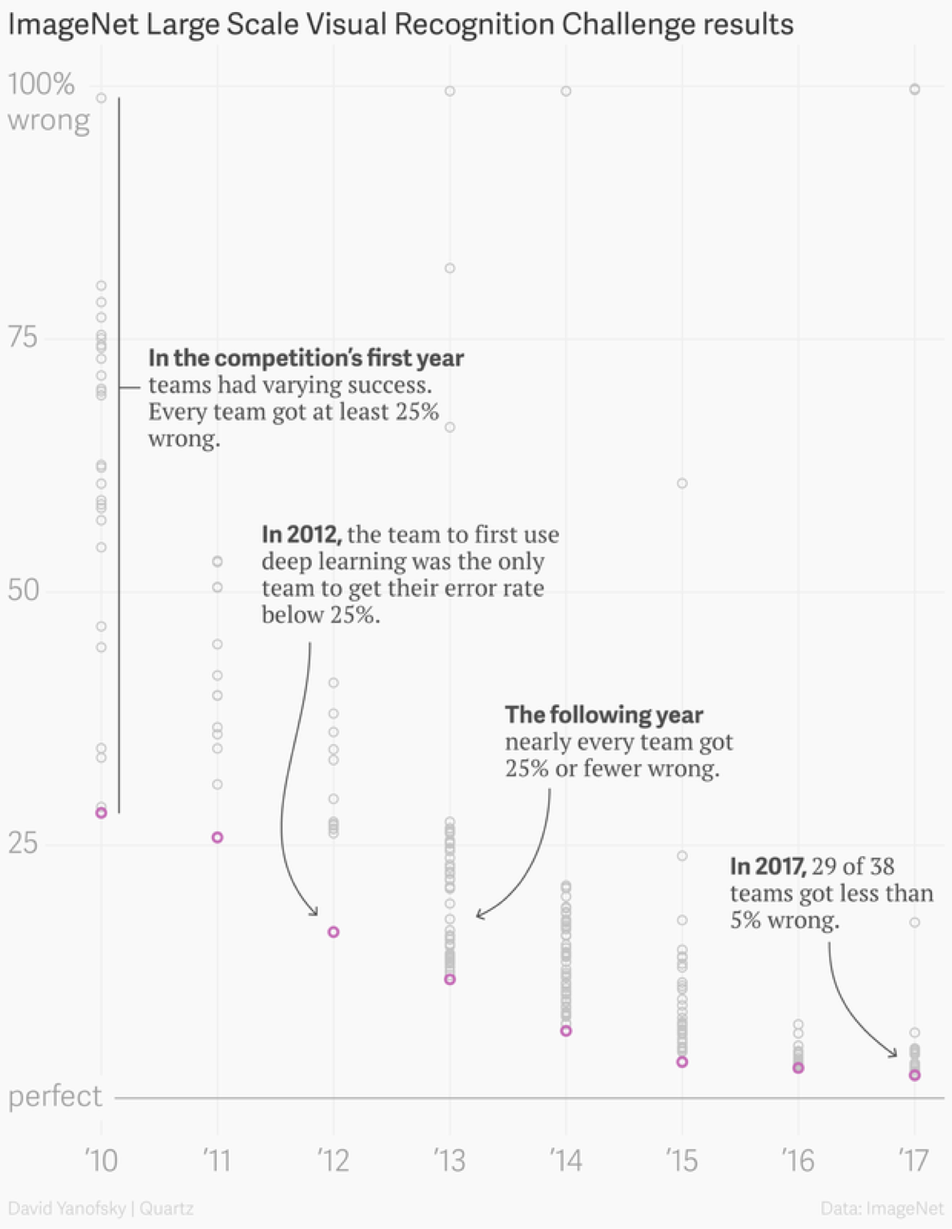

Slide 52
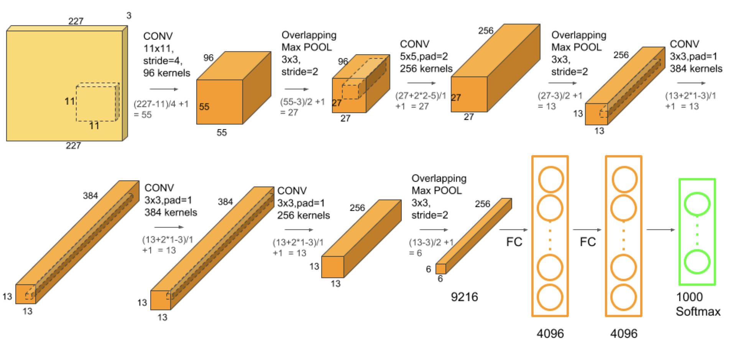
AlexNet is the name of a convolutional neural network which has had a large impact on the field of machine learning, specifically in the application of deep learning to machine vision. It famously won the 2012 ImageNet LSVRC-2012 competition by a large margin (15.3% VS 26.2% (second place) error rates).
The network had a very similar architecture as LeNet by Yann LeCun et al but was deeper, with more filters per layer, and with stacked convolutional layers. It consisted of 11×11, 5×5,3×3, convolutions, max pooling, dropout, data augmentation, ReLU activations, SGD with momentum. It attached ReLU activations after every convolutional and fully-connected layer. AlexNet was trained for 6 days simultaneously on two Nvidia Geforce GTX 580 GPUs which is the reason for why their network is split into two pipelines.

Slide 53
After ImageNet
2017 was the final year of the ImageNet competition
Many people consider it to be “solved” – the error rate is now around 2%
ImageNet inspired many subsequent research efforts

Slide 54
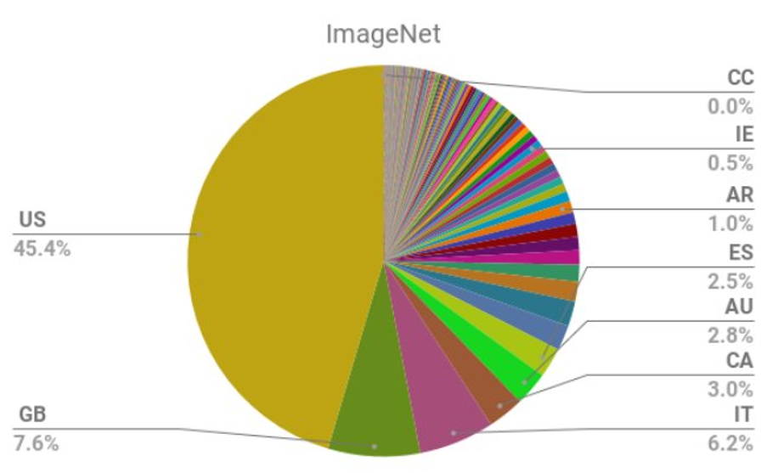
Representativeness of Datasets
Notes:
Over 2/3 of the images in ImageNet, the most studied image data set in the world, are from the Western world (USA, England, Spain, Italy, Australia).
https://arxiv.org/abs/1711.08536

Slide 55
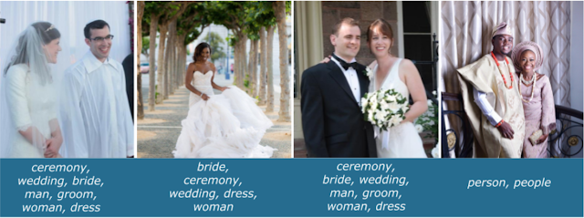
Representativeness of Datasets
Notes:
The release of large, publicly available image datasets, such as ImageNet, Open Images and Conceptual Captions, has been one of the factors driving the tremendous progress in the field of computer vision. While these datasets are a necessary and critical part of developing useful machine learning (ML) models, some open source data sets have been found to be geographically skewed based on how they were collected. Because the shape of a dataset informs what an ML model learns, such skew may cause the research community to inadvertently develop models that may perform less well on images drawn from geographical regions under-represented in those data sets. For example, the images below show one standard open-source image classifier trained on the Open Images dataset that does not properly apply “wedding” related labels to images of wedding traditions from different parts of the world.
https://ai.googleblog.com/2018/09/introducing-inclusive-images-competition.html

Slide 56
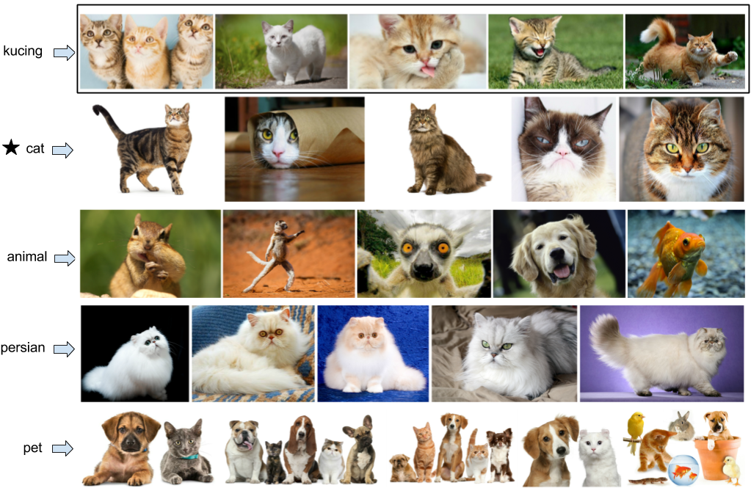
Representativeness of Datasets

Slide 57
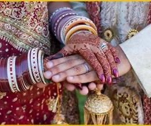
Representativeness of Datasets

Slide 58
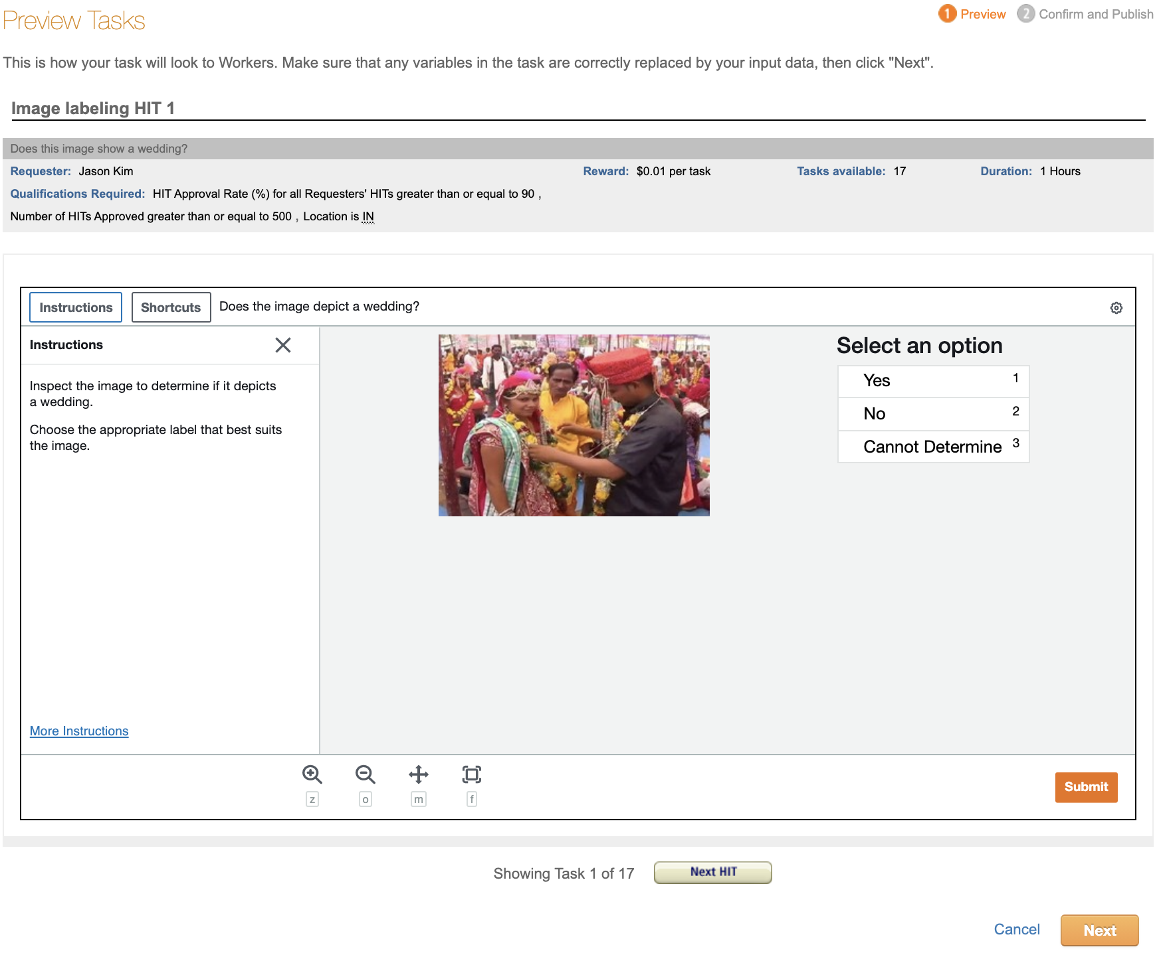
This week’s Homework: Become a Requester

Slide 59
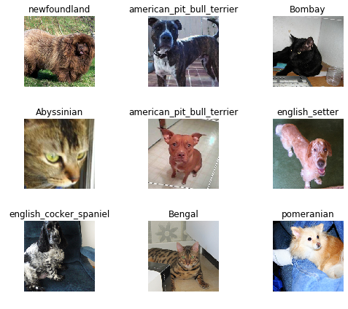
Next week’s HW: train a classifier

